Slide 1
Chapter 5 Data Structures

Slide 2
Data Structures
5.1
When writing programs, we usually use variables to store data.
However, when it comes to storing a lot of related data items, we will use data structures to organise the data.

Slide 3
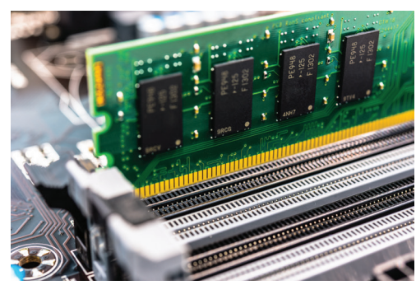
Data Structures
5.1
Data is stored in computer memory cells arranged in a row. Each computer memory location stores only one piece of data.
Data structures refer to the methods of storing and organising data in the computer memory. They determine the sequences and locations of data items in the computer memory.

Slide 4
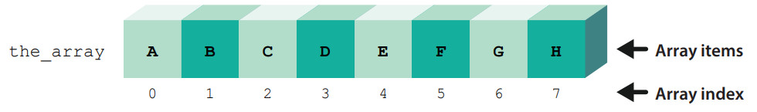
Arrays
A
As mentioned in Module D of the Compulsory Part, an array is a simple linear data structure that stores a set of data sequentially in a continuous computer memory.
The following diagram shows an array that arranges data items in a row:

Slide 5
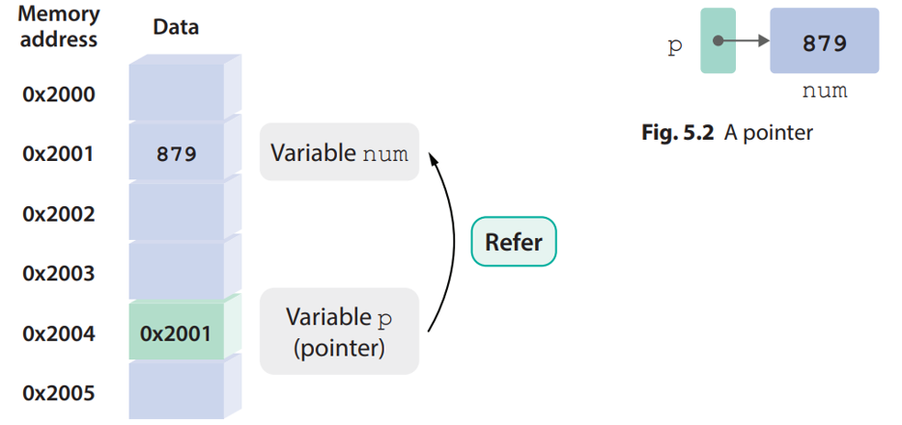
Pointers
B
A pointer is a variable for storing computer memory address, which is usually the address of another variable. A pointer can be compared to an arrow in that it points to a specific variable.

Slide 6
Pointers
B
Data structures have different methods of data organisation as well as ways of manipulation.
This chapter will explain three common data structures individually and they will be represented using arrays and pointers:
stack (堆疊)
queue (隊列)
linked list (鏈表)

Slide 7

Stacks
5.2
Imagine that you are a librarian. You need to take books from a bookshelf and put them onto another bookshelf.
While you are taking out the books, they are stacked up and the first one you have taken out becomes the bottom of the stack.

Slide 8

The concept and manipulation of stacks
A
While you are putting the books back onto the bookshelf, you pick up the one at the top of the stack, i.e. the last book you have taken out.
This mode of manipulation is called Last-In First-Out (LIFO).

Slide 9
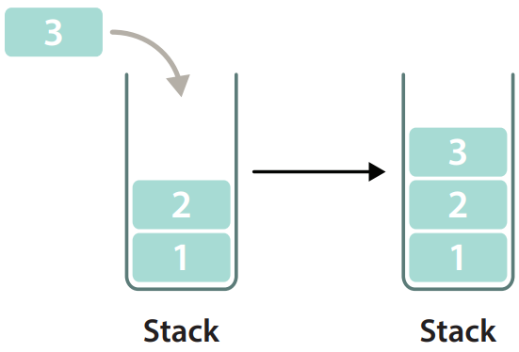
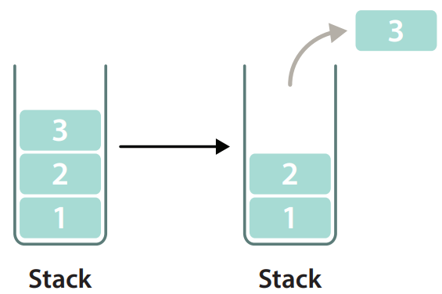
The concept and manipulation of stacks
A
A stack is a data structure that adopts the above mode of manipulation.
When you add (push) a data item into a stack, the item will be added to the top of the stack.
when you remove (pop) a data item from a stack, the removed item will be the one at the top of the stack.

Slide 10

Application of stacks in computer systems
B
The “undo” (復原) and “redo” (取消復原) operations that we frequently perform make use of the stack data structure.

Slide 11
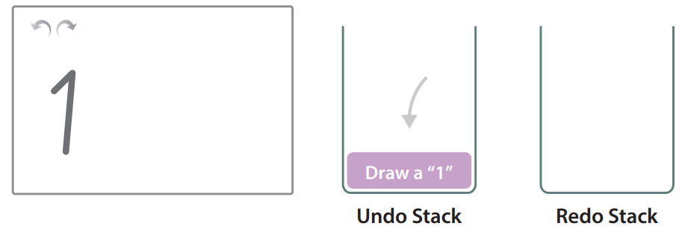
Application of stacks in computer systems
B
Suppose that we are using a drawing software:
1. When we perform an operation, it will be added to the undo stack.

Slide 12
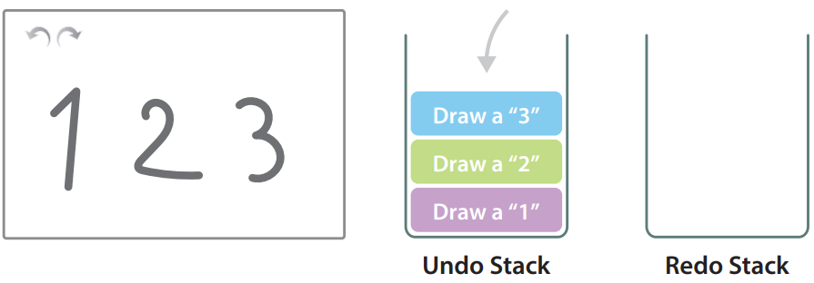
Application of stacks in computer systems
B
2. When we perform another operation, it will be added on top of the previous operation.

Slide 13
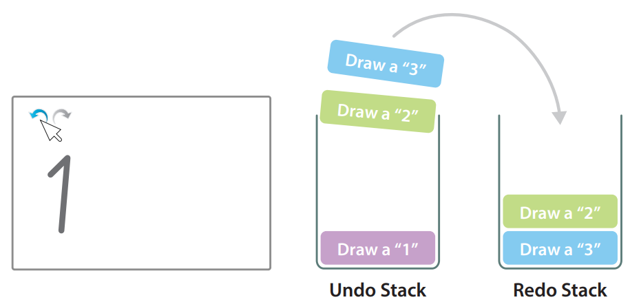
Application of stacks in computer systems
B
3. If we press the “undo” button, the program will follow the last-in first-out mode of manipulation, which means taking our last operation from the undo stack and put it into the redo stack.

Slide 14
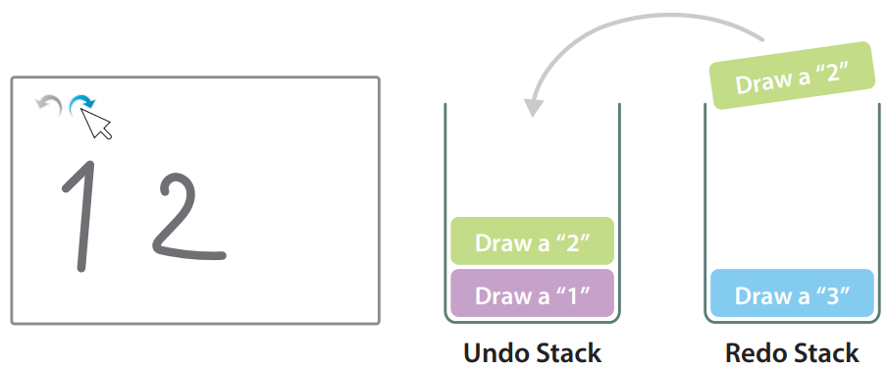
Application of stacks in computer systems
B
4. If we press the “redo” button, the program will pop the last operation that we have undone from the redo stack and put it back into the undo stack.

Slide 15
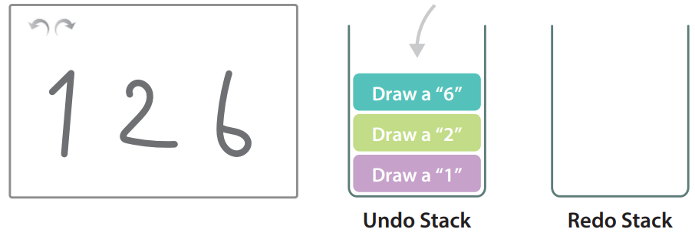
Application of stacks in computer systems
B
5. When we perform the next operation, the program will clear the redo stack.

Slide 16
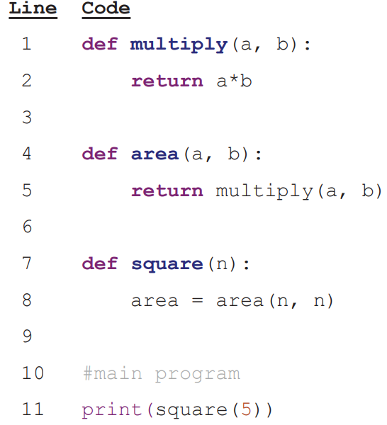
Application of stacks in computer systems
B
Moreover, we need to use stacks when a program calls its sub-program. Call stack (調用堆疊) is a stack stored in RAM and used to coordinate sub-programs.

Slide 17
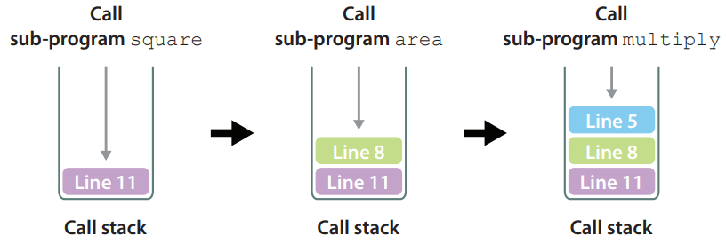
Application of stacks in computer systems
B
When we call a sub-program, its stack frame, which stores information such as return address, will be pushed into the call stack.

Slide 18
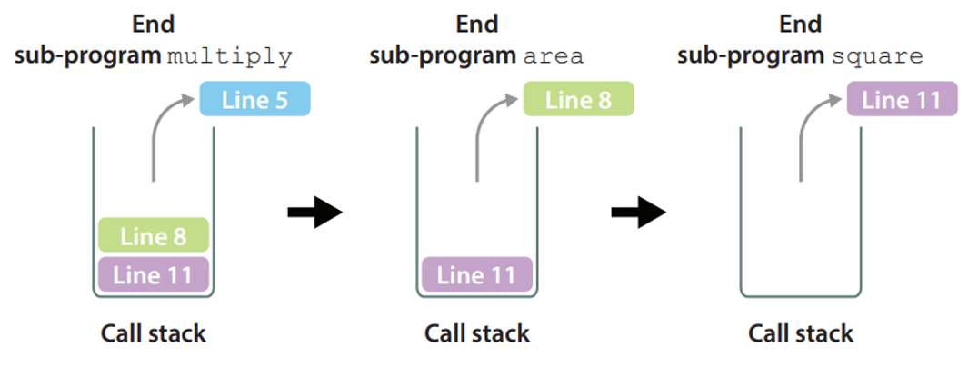
Application of stacks in computer systems
B
When the sub-program has been executed, its stack frame will be popped. The following is the operating principle of a call stack.

Slide 19
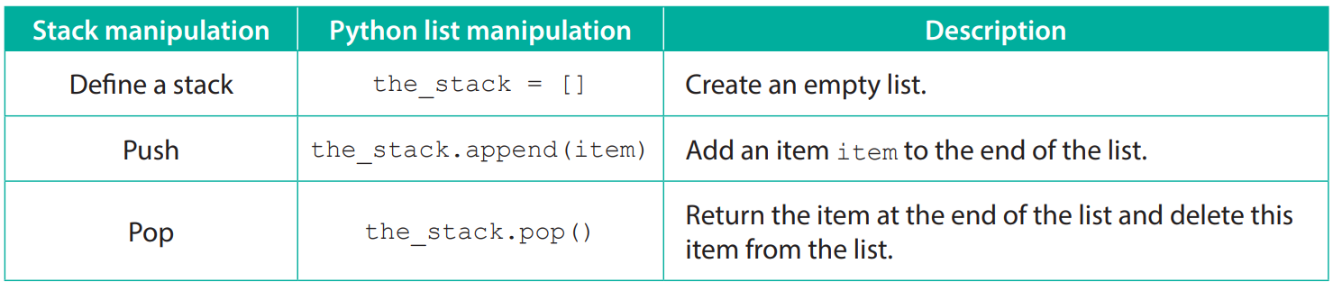
Manipulation of stacks in Python
C
We can use a Python list to store items in a stack and implement various stack manipulations. See the following basic stack manipulations:

Slide 20
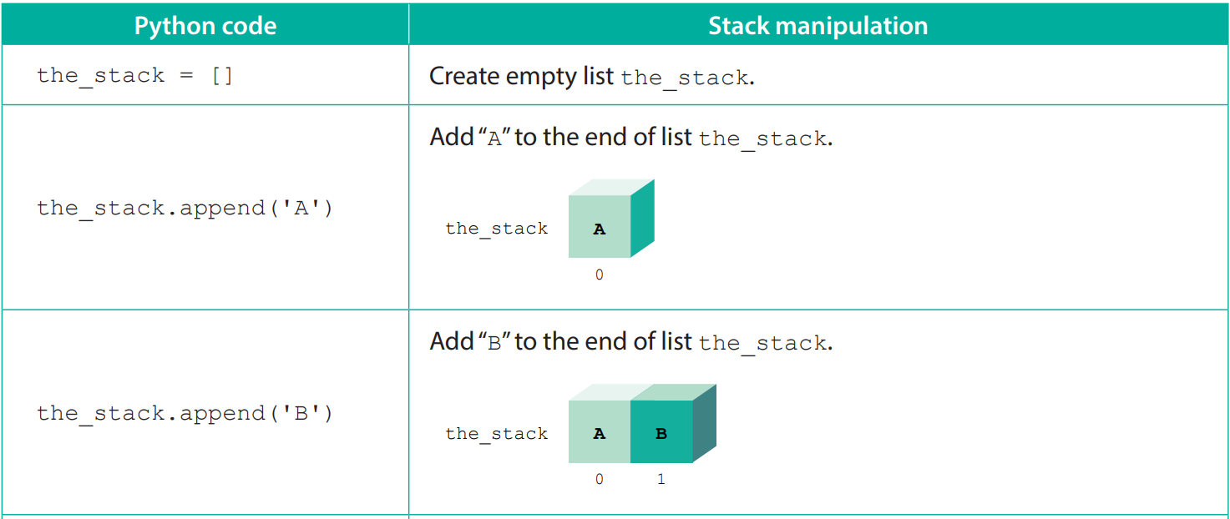
Manipulation of stacks in Python
C
The following diagrams explain how to implement stack manipulations using a list:

Slide 21
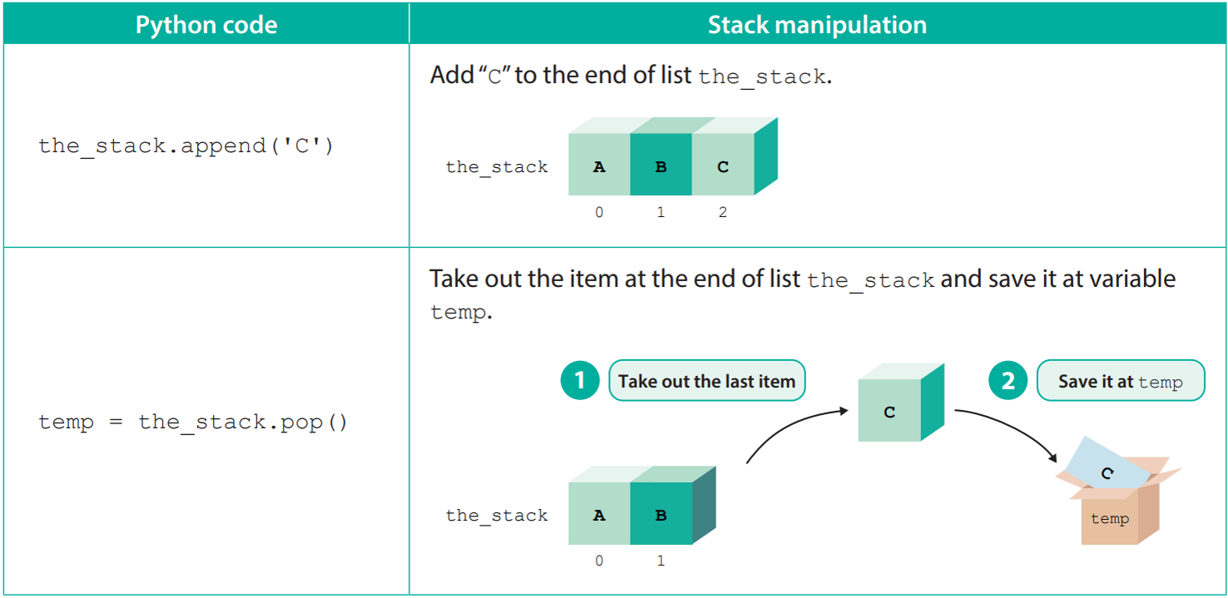
Manipulation of stacks in Python
C

Slide 22
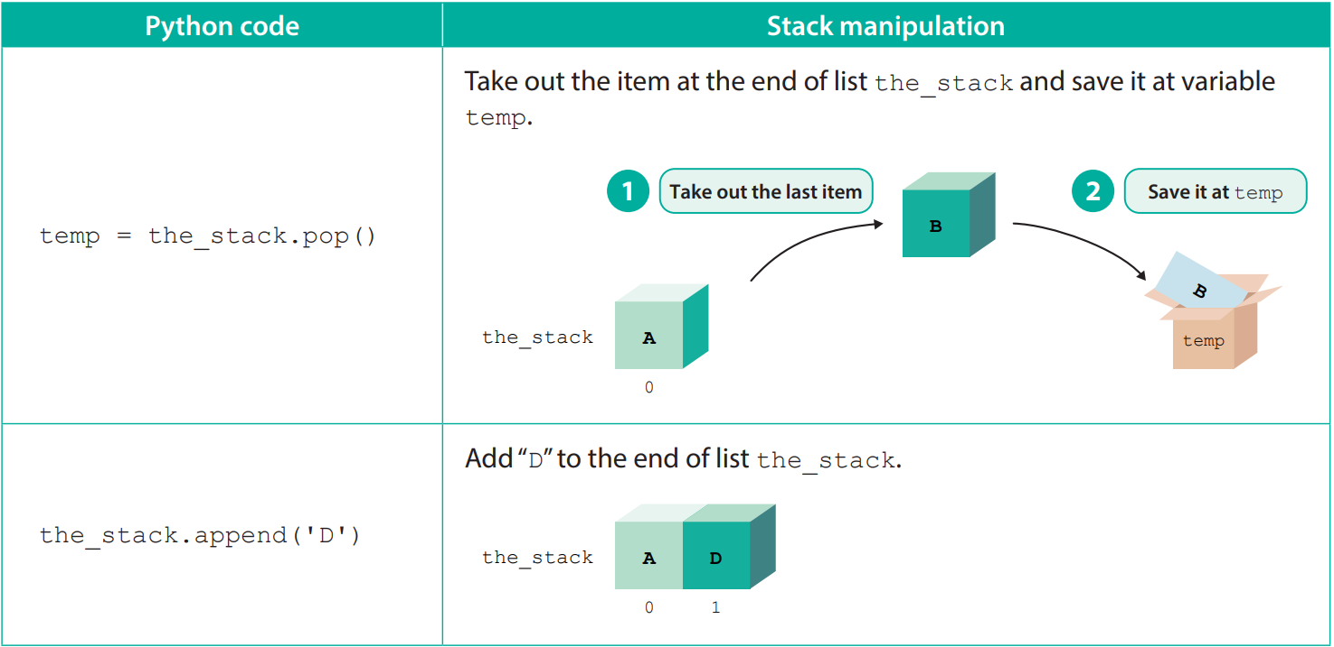
Manipulation of stacks in Python
C

Slide 23
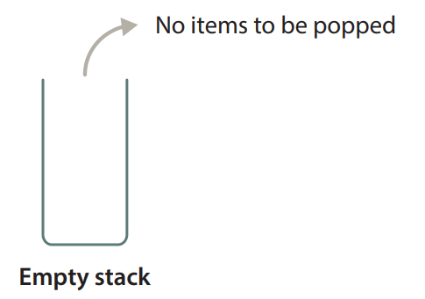
Manipulation of stacks in Python
C
Before performing stack manipulations, there are two things that we need to pay attention to:
1. We cannot pop items from an empty stack, otherwise an underflow error will occur.

Slide 24
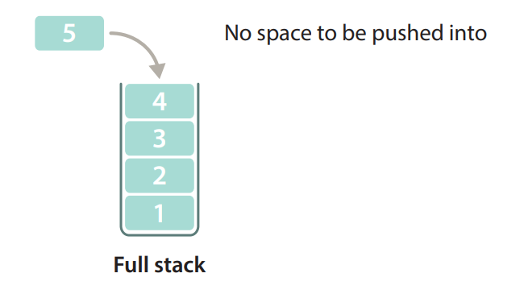
Manipulation of stacks in Python
C
2. We cannot push items into a full stack, otherwise an overflow error will occur.

Slide 25
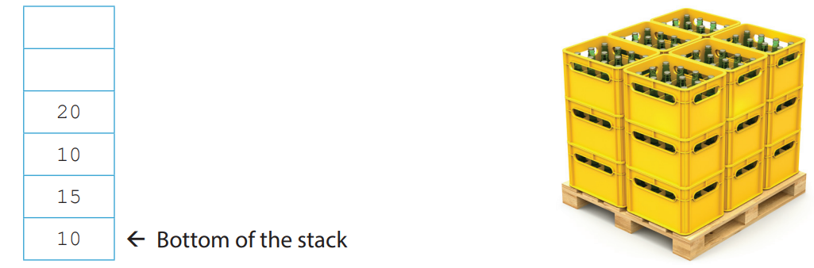
5.1
1. Austin uses stacks to manage plastic boxes storing soft drinks. The following stack has four plastic boxes, which store 10, 15, 10 and 20 bottles of soft drinks respectively, as shown below:

Slide 26
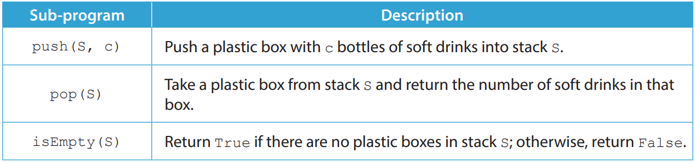
5.1
Refer to the following sub-programs for stack manipulations:

Slide 27
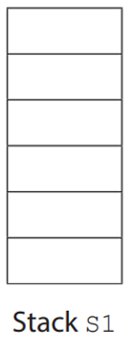
5.1
(a) (i) Suppose that initially there is an empty stack S1. Write down the content of stack S1 after the following algorithm has been executed.
push(S1, 30) push(S1, 10) push(S1, 10) push(S1, pop(S1)+pop(S1)) push(S1, 25)

Slide 28
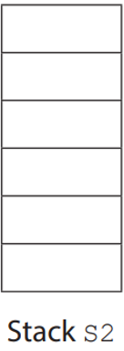
5.1
(ii) Suppose that initially there is an empty stack S2. Write down the content of stack S2 after the following algorithm has been executed.
push(S2, 20) push(S2, 10) pop(S2) if isEmpty(S2) then push(S2, 15) else push(S2, 25)

Slide 29
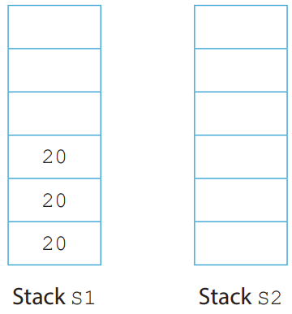
5.1
(b) Suppose that the initial content of stack S1 and stack S2 is as follows:
Write down the content of stacks S1 and S2 after the following algorithm has been executed.
temp ← 0 while not isEmpty(S1) temp ← temp + pop(S1) if temp > 25 then push(S2, 25) temp ← temp – 25 push(S2, temp)

Slide 30
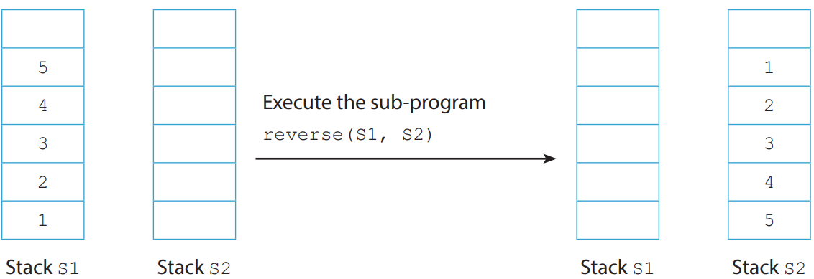
5.1
(c) Austin writes the sub-program reverse(A, B) to move all the plastic boxes in stack A to stack B, where the boxes in B are in reverse order. Suppose that there are a non-empty stack S1 and an empty stack S2, the content of S1 and S2 after the sub-program reverse(S1, S2) has been executed is as shown below:

Slide 31
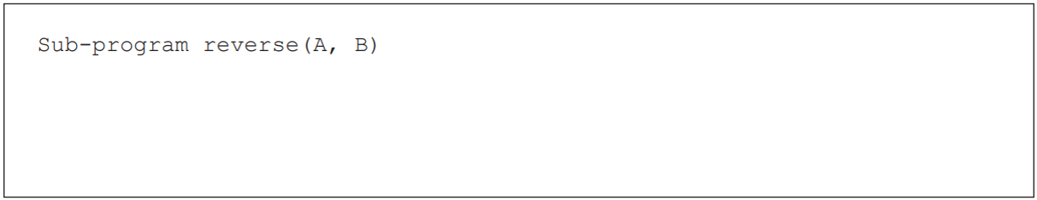
5.1
Complete the pseudocode for the sub-program reverse(A, B).

Slide 32
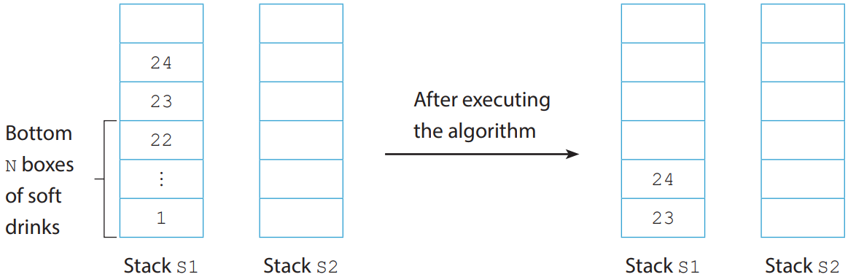
5.1
(d) Austin finds that the soft drinks in the bottom N boxes in stack S1 are expired. He plans to use the sub-program reverse(A, B) to design an algorithm, so that he can remove the bottom N plastic boxes in stack S1 and keep the remaining boxes in the original order in S1. Suppose that initially there are a non-empty stack S1 and an empty stack S2, the content of S1 and S2 after the algorithm has been executed is as shown below:

Slide 33
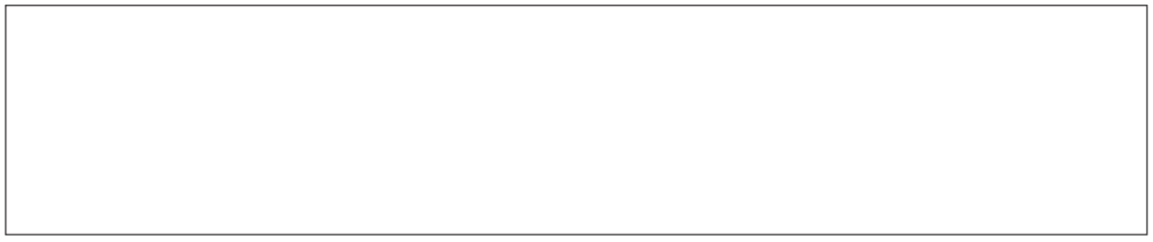
5.1
Complete the algorithm for Austin.

Slide 34
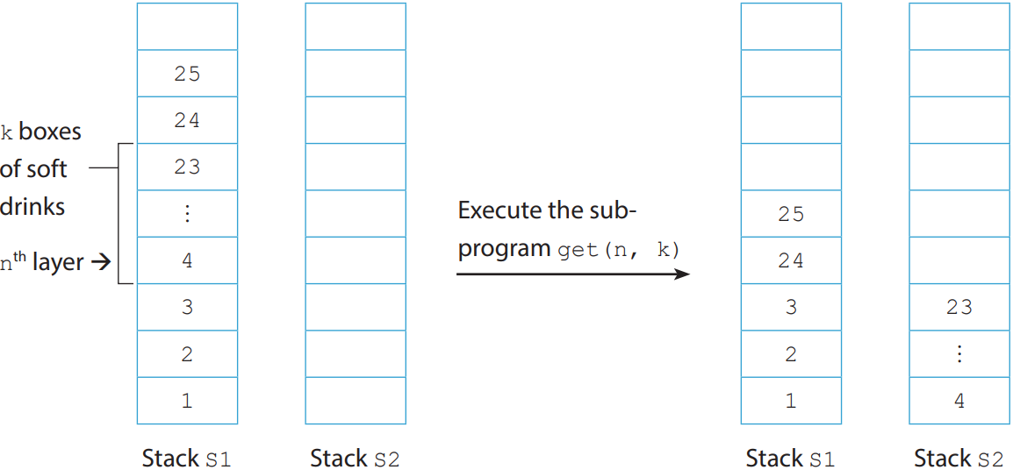
5.1
(e) Austin finds that at the nth layer of stack S1, there are k boxes of soft drinks that are not placed in the designated stacks for their brands. He plans to design a sub-program get(n, k), so that he can move the k boxes of soft drinks at the nth layer of stack S1 to stack S2, and keep the remaining boxes in the original order in S1. Suppose that initially there are a non-empty stack S1 and an empty stack S2, the content of S1 and S2 after the algorithm has been executed is as shown below:

Slide 35
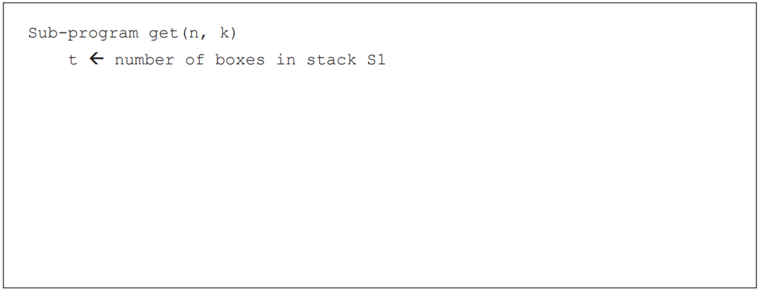
5.1
Complete the pseudocode for the sub-program get(n, k) for Austin. New stacks can be added when needed.

Slide 36
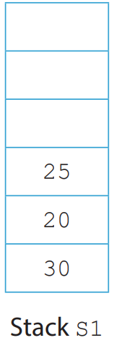
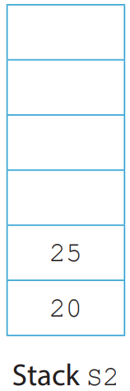
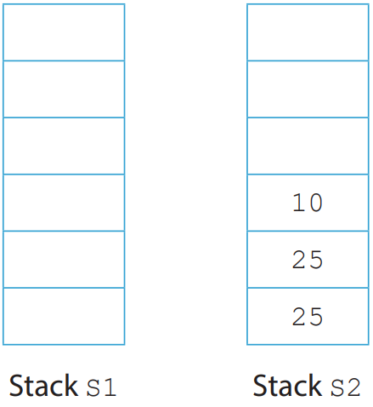
5.1
◣ Solution
(a) (i) (ii) (b)

Slide 37
5.1
(c) while not isEmpty(A) push(B, pop(A))
(d) reverse(S1, S2)
for i from 1 to N
pop(S2)
reverse(S2, S1)

Slide 38
5.1
(e) define stack S3
for i from t down to n
push(S3, pop(S1))
for i from 1 to k
push(S2, pop(S3))
reverse(S3, S1)

Slide 39
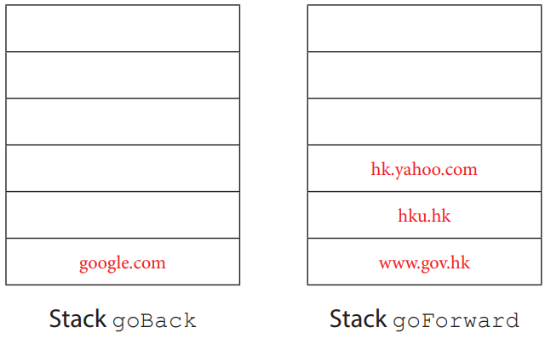
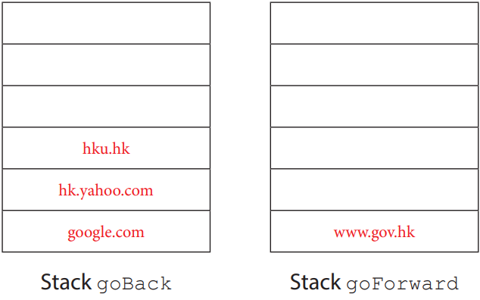
5.1
Complete Checkpoint 5.1 on P. 164 of the textbook.
(a) (i)
(ii)

Slide 40
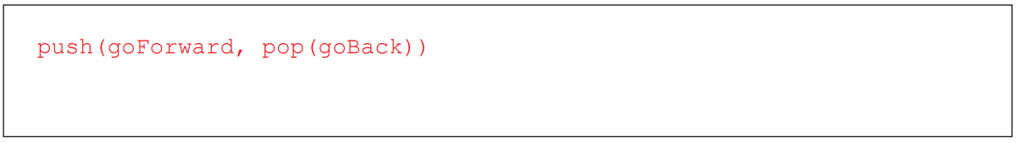
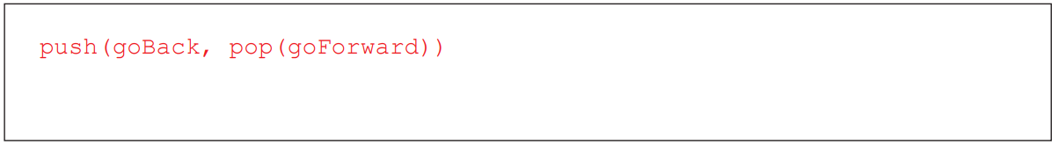
5.1
(b) (i)
(ii)

Slide 41
5.1
(c) No action
(d) Firstly, remove the bottommost item in goForward. Then, perform the stack manipulation for clicking “go back”, i.e. push(goForward, pop(goBack)).

Slide 42
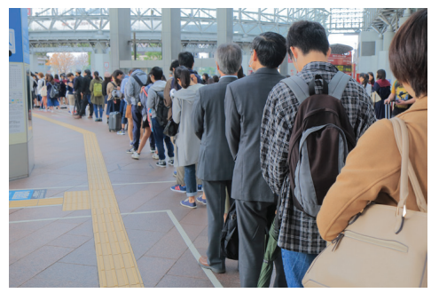
Queues
5.3
Suppose that you are now waiting in a queue outside a newly opened restaurant. The restaurant has no table reservation system.
Instead, it let diners enter sequentially using the first-come, first-served approach.

Slide 43
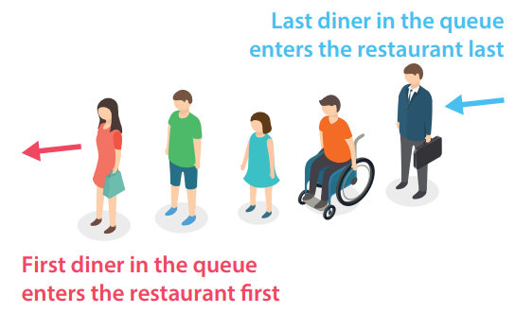
The concept and manipulation of queues
A
Since you are the first diner in the queue, you can enter the restaurant first. This mode of manipulation is called First-In First-Out (FIFO).

Slide 44
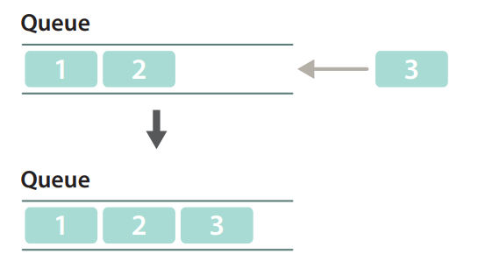
The concept and manipulation of queues
A
A queue is a data structure that adopts the above mode of manipulation.
When you add a data item to a queue (enqueue), that data item will be added to the end of the queue.

Slide 45
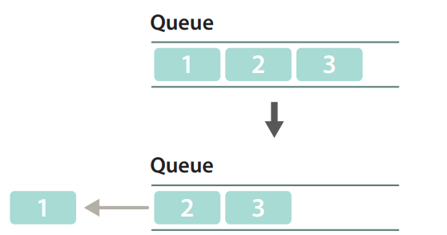
The concept and manipulation of queues
A
When you take a data item from the queue (dequeue), the removed item will be the one at the beginning of the queue, i.e. the first item that you have added.

Slide 46
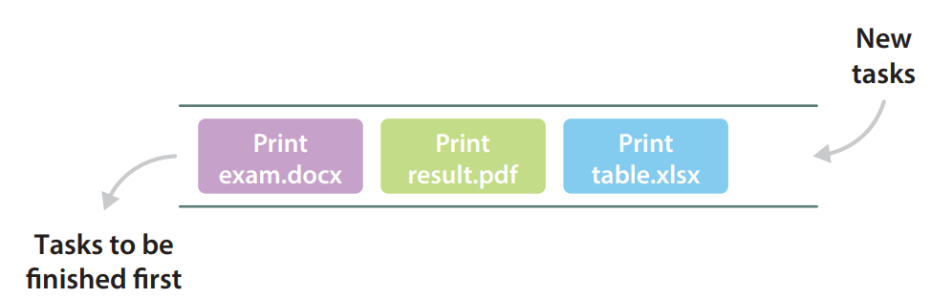
Application of queues in computer systems
B
Queues are widely applied in computer systems. For example, the order of printing documents is stored as a queue in the printer memory.

Slide 47
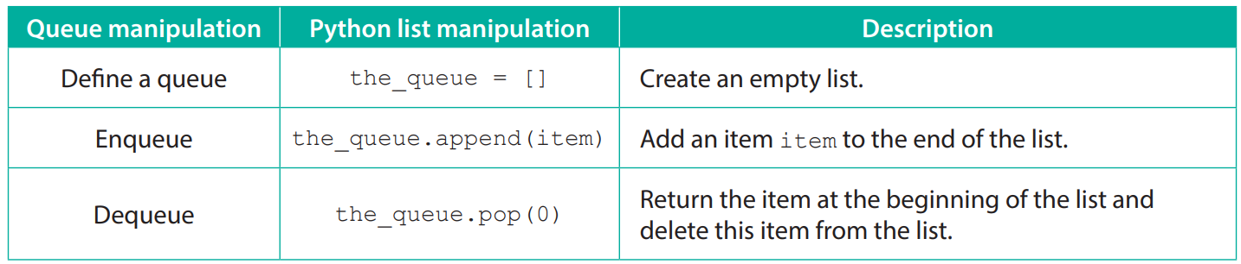
Manipulation of queues in Python
C
We can use a Python list to store items in a queue and implement various queue manipulations. See the following basic queue manipulations:

Slide 48

Manipulation of queues in Python
C
The following diagrams explain how to implement queue manipulations using a list:

Slide 49
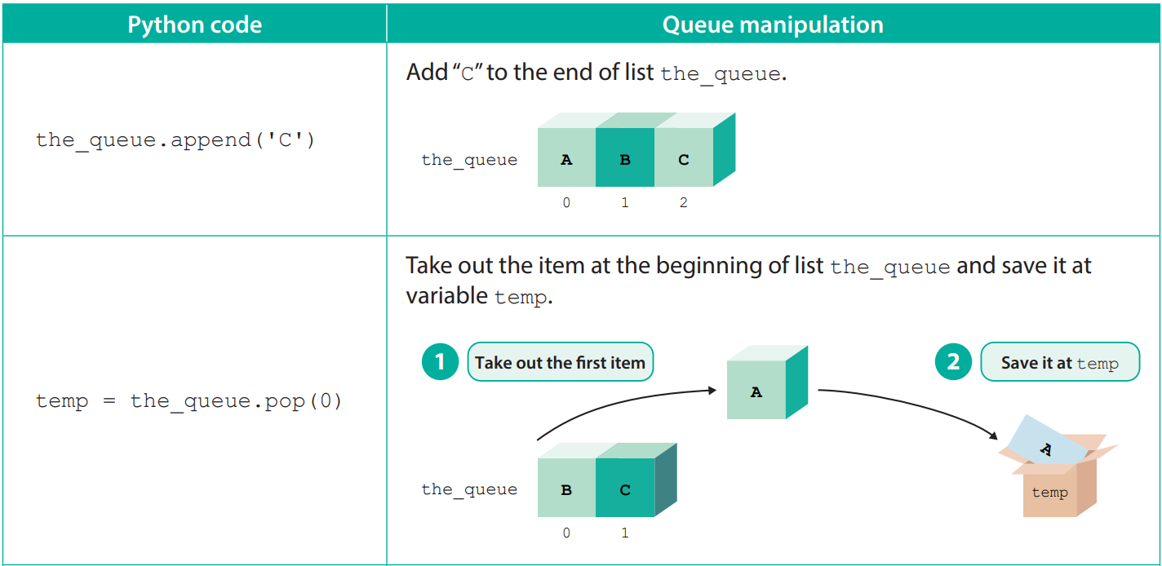
Manipulation of queues in Python
C

Slide 50
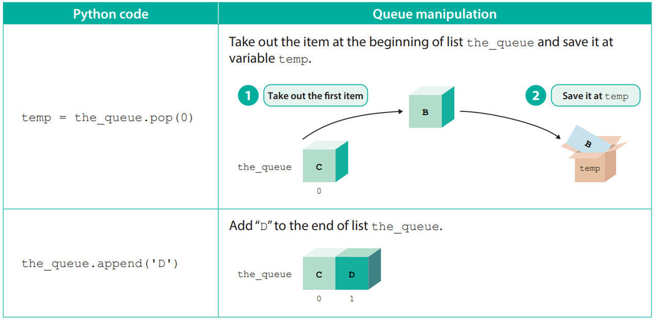
Manipulation of queues in Python
C

Slide 51
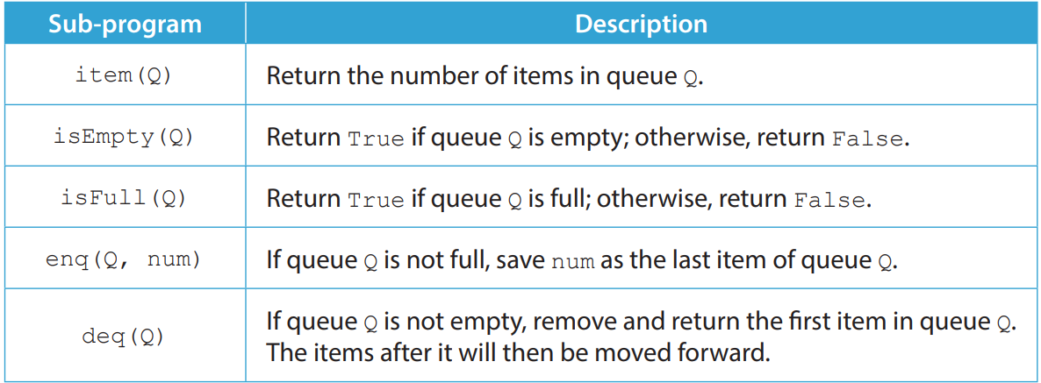
5.2
1. Marco creates a number array Q with indexes from 1 to 10 and manipulates the array as a queue:
Refer to the following sub-programs for queue manipulation:

Slide 52
5.2
(a) Write down the content of array Q after the following algorithm has been executed.
enq(Q, 20) deq(Q) deq(Q)

Slide 53
5.2
(b) Marco writes the pseudocode for the sub-program isEmpty(Q), as follows:
Sub-program isEmpty(Q) if item(Q) = 0 then return True else return False
Write the pseudocode for the sub-program isFull(Q).

Slide 54
5.2
(c) Complete the pseudocode for the following sub-program enq(Q, num) for Marco.
Sub-program enq(Q, num) if ______________ then Output "Unsuccessful“ else ______________

Slide 55
5.2
(d) Write the pseudocode for the sub-program deq(Q).
Sub-program deq(Q) return temp

Slide 56
5.2
◣ Solution
(a) Content of array Q:
(b) Sub-program isFull(Q) if item (Q) = 10 then return True else return False

Slide 57
5.2
(c) Sub-program enq(Q, num) if isFull(Q) then Output "Unsuccessful" else Q[item(Q) + 1] ← num
(d) Sub-program deq(Q) if isEmpty(Q) then Output "Unsuccessful" else temp ← Q[1] for i from 1 to item(Q)-1 Q[i] ← Q[i+1] Q[item(Q)] = "" return temp

Slide 58
Queues manipulated with pointers
E
To enhance the efficiency of queue manipulation, we can use two pointers (head and tail) to indicate the first and last items of the queue respectively.
Whenever adding or deleting an item, we simply have to move the pointers.

Slide 59
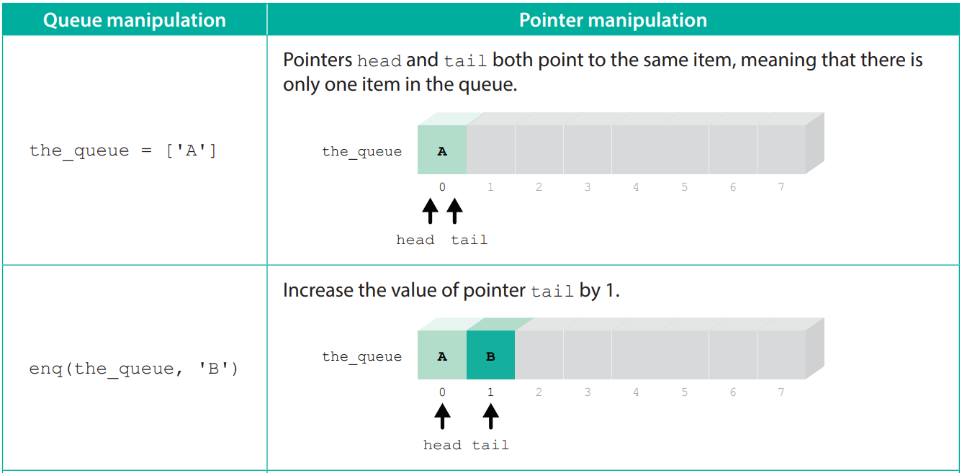
Queues manipulated with pointers
E

Slide 60
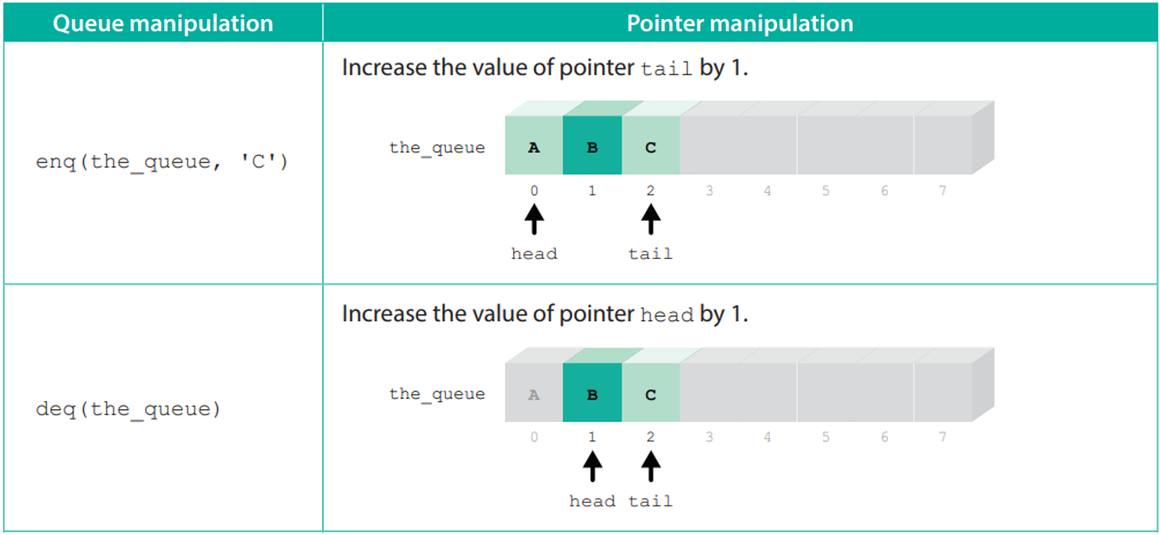
Queues manipulated with pointers
E

Slide 61
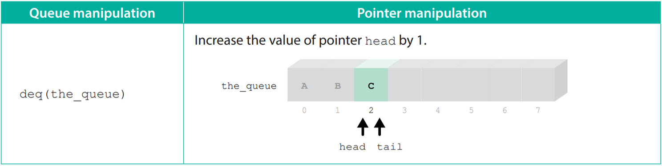
Queues manipulated with pointers
E

Slide 62
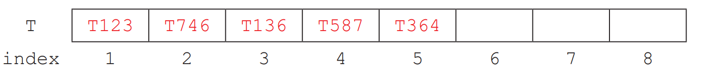
5.2
Complete Checkpoint 5.2 on P. 173 of the textbook.
(a) (i)
P = 2 Q = 5
(ii)
P = 4 Q = 8

Slide 63
5.2
(b) P > Q
(c) Overflow error (index out of range)

Slide 64

The concept and manipulation of circular queue
F
As shown in the pointers manipulation above, in the case of an array with a fixed size, we can neither add new items nor reuse the array items once the tail of the queue reaches the end of the array.
This way of manipulation wastes computer resources.

Slide 65

The concept and manipulation of circular queue
F
To solve this problem, we can simply reset the pointers. When a pointer reaches the end of the array, the next value of the pointer is reset to the index of the first item in the array. In this way, a circular queue is formed.

Slide 66

The concept and manipulation of circular queue
F

Slide 67

The concept and manipulation of circular queue
F

Slide 68

The concept and manipulation of circular queue
F

Slide 69

The concept and manipulation of circular queue
F
Same as stack manipulations, before performing queue manipulations, there are two things that we need to pay attention to:
1. We cannot pop an item from an empty queue, otherwise an underflow error will occur.

Slide 70

The concept and manipulation of circular queue
F
2. We cannot push an item into a full queue, otherwise an overflow error will occur.

Slide 71


5.3
1. Steve is a programmer at an IT company. He is developing for a bank a ticketing program for VIP counter services. Steve uses an array T with indexes from 0 to 9 to store the names of the waiting customers, and uses the following variables and sub-programs to process array T:

Slide 72
5.3
Assume that N = 3 and first = 7, and the initial content of array T is as follows:
Then, after executing delQ(T), N = 2, first = 8 and the content of array T is:
Then, after executing addQ(T, Katie), N = 3, first = 8 and the content of array T is:

Slide 73
5.3
(a) Next, execute the following algorithm:
addQ(T, Dan) delQ(T) delQ(T) addQ(T, Alan) delQ(T) addQ(T, Ellen)
(i) What is the content of array T?
(ii) What is the value of variable N?
(iii) What is the value of variable first?
(iv) What is the return value of calling the sub-program last(T)?

Slide 74
5.3
(b) The above ticketing service is provided with a first-come-first-served approach. What data structure does array T use to process the data?
(c) Write the pseudocode for the sub-program delQ(T).
Sub-program delQ(T) if N = 0 then temp ← "Unsuccessful" else temp ← _______ T[_______] ← "" N ← _______ if _______ then first ← 0 else first ← first + 1 return temp

Slide 75
5.3
(d) Write the pseudocode for the sub-program addQ(T, name). Sub-program addQ(T, name) if _______ then Output "Service is busy" else T[_______] ← name N ← _______

Slide 76
5.3
(e) Write the pseudocode for the sub-program last(T).
Sub-program last(T) if N = 0 and first = 0 then return 9 else

Slide 77
5.3
◣ Solution
(a) (i) The content of array T:
(ii) 3
(iii) 1
(iv) 3

Slide 78
5.3
(b) Queue
(c) temp ← T[first] T[first] ← " " N ← N – 1 if first = 9 then first ← 0 else first ← first + 1

Slide 79
5.3
(d) if N = 10 then Output "Service is busy“ else T[(last(T)+1) % 10] ←name N ← N + 1
(e) if (first+N-1) <= 9 then return (first + N - 1) else return (first + N - 1) % 10

Slide 80
5.3
Complete Checkpoint 5.3 on P. 180 of your textbook.
(a) N
(b)
start = 3 next = 1

Slide 81
5.3
(c) Sub-program push(TAXI, no) if (next + 1) % N = start then Output "The queue is full.“ else TAXI[next] ← no next ← (next + 1) % N
Sub-program pop(TAXI) if start = next then return "No taxi" else start ← (start + 1) % N return TAXI[start]

Slide 82
5.3
(d) Sub-program waiting(TAXI) if next >= start return next – start else return N - (start - next)
(e) total ← 0 i ← start while i != next if P[i] = 5 then total ← total + 1 i ← (i + 1) % N Output total

Slide 83

Linked Lists
5.4
A linked list is formed by many nodes. Each node stores its own data and a pointer, which stores the address of the next node. Nodes in the linked list are all connected by pointers.

Slide 84


The concept and manipulation of linked lists
A
To add a new node to or delete a node from the linked list, we simply need to modify the pointers of the nodes.

Slide 85
The concept and manipulation of linked lists
A
Stack and queue data structures only allow us to add data at their ends, while a linked list lets us insert new data in the middle of a row of data items.
Therefore, a linked list is more flexible than the previous two data structures.

Slide 86

Application of linked lists in computer systems
B
After a file system has been used for a long time, a lot of files are created, edited and deleted. Files are stored in storage devices in the form of separate fragments.
A linked list is one of the data structures used in memory management. The computer system connects all fragments of a file using a linked list.

Slide 87
Application of linked lists in computer systems
B
File A connected by a linked list:

Slide 88
Differences between linked lists and arrays
C
Linked lists and one-dimensional arrays have similar uses in that both can store a series of data.
However, as mentioned in Module D of the Compulsory Part, an array can store the same type of data only. On the contrary, a linked list can store different types of data.

Slide 89

Differences between linked lists and arrays
C
Moreover, since an array stores data in a continuous memory, the computer can use the index to calculate the memory address quickly and easily, and access a given item directly.
This method of data access is called direct access (also known as random access).

Slide 90

Differences between linked lists and arrays
C
Since a linked list connects nodes by pointers, data items do not need to be stored in a continuous memory, instead, they can be stored separately in different locations.
When we need to access the data item at a given location, we can only search the list from the beginning and follow the pointers. This access method is called sequential access.

Slide 91

Differences between linked lists and arrays
C
Although arrays are more convenient than linked lists in terms of data access, adding or deleting items in arrays is more complicated.
For instance, if we need to add an item to an array, we must move the items after a given location backwards one by one.

Slide 92

Differences between linked lists and arrays
C
In addition, to delete an item, we need to move the items after a given location forwards one by one.

Slide 93

Differences between linked lists and arrays
C
On the other hand, it is simpler to add or delete a node in a linked list. We only need to change the directions of the pointers.

Slide 94

Differences between linked lists and arrays
C
Comparison of arrays and linked lists:

Slide 95


5.4
1. Nicole uses a linked list to store the English names of some MTR stations. The content of the first node in the linked list stores “start”, while the pointer stores the index of the next node. She represents this linked list as arrays, as shown below:

Slide 96
5.4
(a) (i) Nicole uses “-1” to represent a null pointer. Write the content of the nodes in this linked list in order. (ii) Including the first node, how many nodes are there in this linked list?
(iii) Other than “-1”, state the range of values that Nicole can use to represent the null pointer.

Slide 97

5.4
(b) Nicole designs the following sub-programs to manipulate the linked list:
She executes the following code: insert(5, "Kowloon Tong") insert(5, "Prince Edward") delete(2)

Slide 98

5.4
Update the linked list below.

Slide 99
5.4
◣ Solution
(a) (i) start, Whampoa, Ho Man Tin, Yau Ma Tei, Mong Kok
(ii) 5
(iii) Any negative numbers/ If we know the array size, any numbers greater than it

Slide 100

5.4
(b) Content of the linked list:

Slide 101

5.4
2. Anson constructed linked list DLL to store the student numbers of students studying Physics. Each node has two pointers: pointer prev stores the address of the previous node; pointer next stores the address of the next node. The content of the first node in linked list DLL stores “physics”, as shown below:
(a) Assume that “-1” represents a null pointer. Write the content of the nodes on this linked list in order.

Slide 102

5.4
(b) Anson has designed the following sub-programs to manipulate the linked list:
He executes the following code: delete(3) insert(1, "20180322")

Slide 103

5.4
Update the linked list below.

Slide 104
5.4
(c) State an advantage and a disadvantage of a doubly linked list.

Slide 105

5.4
◣ Solution
(a) physics, 20180317, 20180236, 20180125 (b) The content of linked list DLL:
(c) Advantage: the nodes in the linked list can be accessed from both directions.
Disadvantage: more memory (storage space) is required.

Slide 106

5.4
Complete Checkpoint 5.4 on P. 193 of your textbook.
(a)
(b) start → Kyle → Daniel → Benson → Mike
(c) The memory (storage space) required is less.

Slide 107

5.5
1. Andrew uses two arrays, D and NP, to implement linked list operations. He uses array D and array NP to store the content of nodes and the pointer (i.e. the index of the next node) respectively, as shown below:

Slide 108
5.5
(a) (i) Suppose that the index of the first node on the linked list is 5, write down the content of the nodes in the right order.
(ii) How many nodes are there on this linked list?
(iii) What numerical value is used by Andrew to represent a null pointer?

Slide 109

5.5
(b) Andrew designs the following sub-programs to manipulate the linked list:

Slide 110


5.5
(i) After executing delete(3), what will the content of arrays D and NP become?
(ii) After executing insert(2, Brian, 4), what will the content of arrays D and NP become?

Slide 111
5.5
(c) Complete the pseudocode for the sub-program length().
Sub-program length() l ← 0 next ← start while next != ______ l ← ______ next ← ______ return l

Slide 112
5.5
(d) Suppose that 1 ≤ n ≤ length(), complete the pseudocode for the sub-program delete(n).
Sub-program delete(n) if n = 1 then start ← ______ else prev ← start current ← NP[start] #Use a for loop to move the current node pointer current to the nth node for k from 2 to n-1 prev ← ______ current ← ______ NP[prev] ← ______

Slide 113
5.5
◣ Solution
(a) (i) Ben, Peter, Iris, Ada
(ii) 4
(iii) 10

Slide 114


5.5
(b) (i) The content of arrays D and NP:
(ii) The content of arrays D and NP:

Slide 115
5.5
(c) while next != 10 l ← l + 1 next ← NP[next]
(d) if n = 1 then start ← NP[start] else prev ← start current ← NP[start] for k from 2 to n-1 prev ← current current ← NP[current] NP[prev] ← NP[current]

Slide 116
5.5
Complete Checkpoint 5.5 on P. 200 of the textbook.
1. (a) painting, tea, yoga, japanese
(b) Sub-program printList() current ← monday while current != null Output schedule[current] current ← ptr[current]

